Slide 1
Microcomputer Principles
&
Computer Interface
Lu Yin
luyin@nwpu.edu.cn

Slide 2
Chapter 9
8086 Microprocessor and ISA Bus
Contains
  State the function of the pins of the 8088
  List the functions of the data, address and control buses
  Describe the ISA bus system
  Explain the role of the ISA bus system

Slide 3
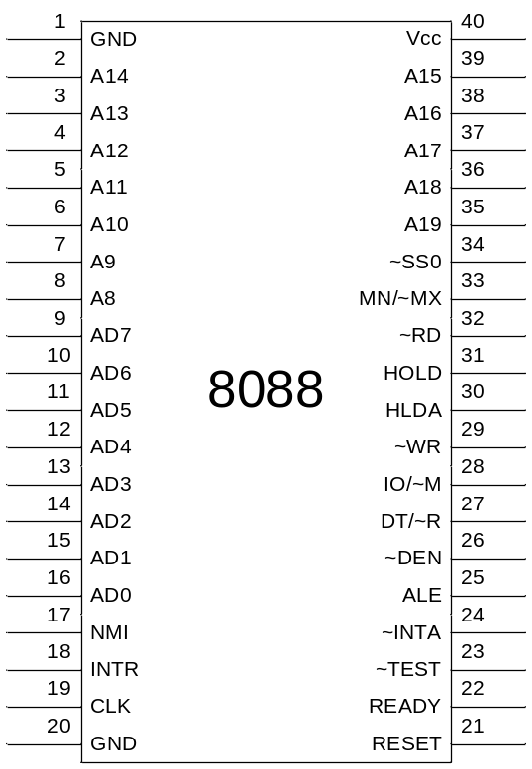
Section9.1
8088 Microprocessor in IBM PC
Microprocessor 8088
  16-bit CPU, 20-bit address space
  40 pin chip
  Two working modes:
    Minimum mode: single chip mode
    Maximum mode: cooperate with 8087 float processor
Differences between 8086&8088
  DB shrinks to 8 bits, while internal still a 16 bit processor

Slide 4
Section9.1
8088 Microprocessor in IBM PC
Microprocessor buses
  Data bus AD0~AD7(pin16~9)
  Address bus AD0~AD7, A8~A19
  The designers multiplexed the address bus and the data bus, so the address must be latched by the peripheral devices
  Control bus is used to provide the signals to indicate the type of operation being executed.
    In minimum and maximum mode, ctrl bus has different definitions

Slide 5
Section9.1
8088 Microprocessor in IBM PC
8088 Control Bus for R/W operation
  2 R/W modes: MEM/Port
  So we need 4 signals (tb9-1)
  8088 provides 3 pins to generate these 4 signals
As AB and DB are multiplexed, how does the device know whether it is data or address available on the bus?
  ALE (address latch enable), when address is available, the cpu enables ALE to indicate that the info on bus is address
RD | WR | IO/~M | Signal
0 | 1 | 0 | ~MEMR
1 | 0 | 0 | ~MEMW
0 | 1 | 1 | ~IOR
1 | 0 | 1 | ~IOW
0 | 0 | X | Never happens

Slide 6
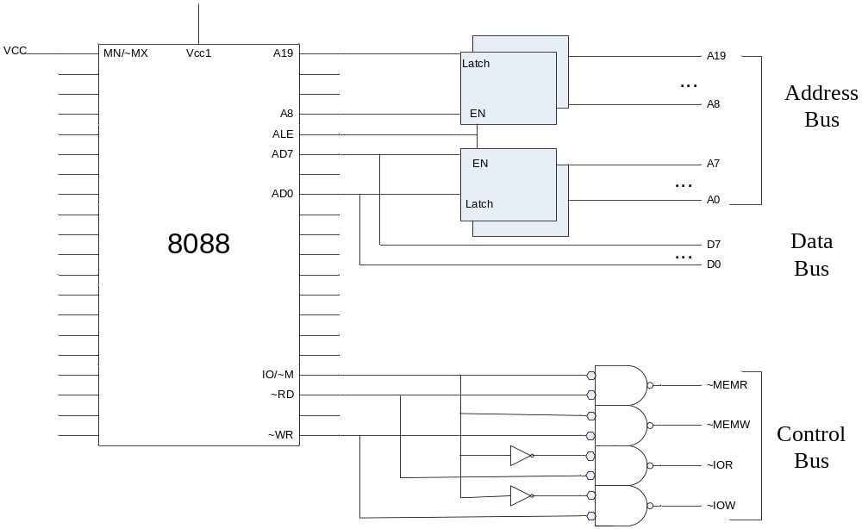
Section9.1
8088 Microprocessor in IBM PC
Figure 9-5 Addr Data Ctrl buses in 8088 based system

Slide 7
Section9.1
8088 Microprocessor in IBM PC
Address Bus
  20 pin assigned to address bus
Data Bus
  Time division multiplexing with D0~D7
Control Bus
  Use RD, WR, IO/M to combine memory / IO read or write control signals

Slide 8
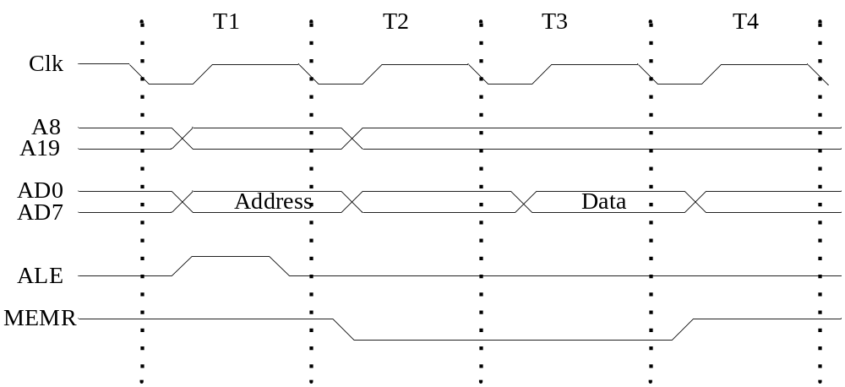
Section9.1
8088 Microprocessor in IBM PC
Bus timing of the 8088
  A round of R/W can be divided into 4 flaps
  ALE is used to latch the address into the address buffer IC

Slide 9
Section9.1
8088 Microprocessor in IBM PC
Other pins of 8088 (minimum mode)
PIN | Name | Function
24 | INTA | Interrupt acknowledge
25 | ALE | Address latch enable
26 | DEN | Data enable, enable CPU to control data base
27 | DT/R | Data transmit/receive indication of data flow in DB
28 | IO/M | Input-output or memory operation indication
29 | WR | Write operation indication
30 | HLDA | Hold acknowledge, response to HOLD request
31 | HOLD | Hold request from peripheral chips
32 | RD | Read operation indication

Slide 10
Section9.1
8088 Microprocessor in IBM PC
Reset of the processor
  If a high state is assigned to the RESET pin, the 8088 will clear all the segment registers (except the CS to be FFFF) and the IP register. Thus the control flow will be redirected to FFFF0H
Power On origin address
  Where to put the BIOS ?

Slide 11
Section9.3
8-bit Section of ISA Bus
Local bus vs. system bus
  Local bus : connect directly to the processor. Any communication with the CPU must go through the local bus.
  System bus : bus of the computer system; It not only provides necessary signals to all the chips on the motherboard, but also goes to the expansion slot for any plug-in expansion card.
  There should be a bridge between them to make an isolation.
Why should local bus and system bus be isolated?
  IO speed.
How to isolate?
  Tri-state buffer IC like 74LS245

Slide 12
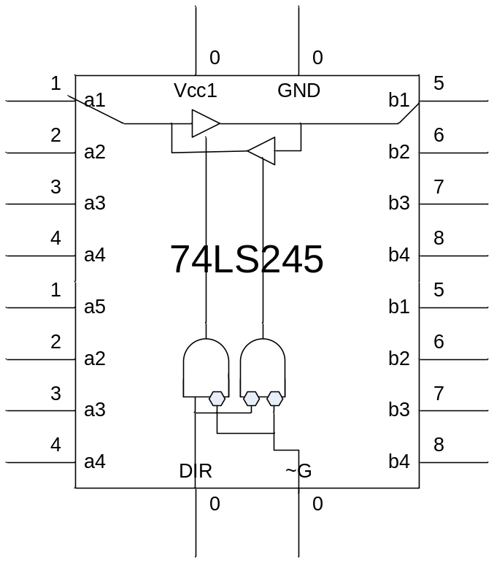
Section9.3
8-bit Section of ISA Bus
Function of 74LS245
Function Table of 74LS245
Enable ~G | Dir Ctrl DIR | Operation
L | L | Bus B to A
L | H | Bus A to B
H | X | Isolation

Slide 13
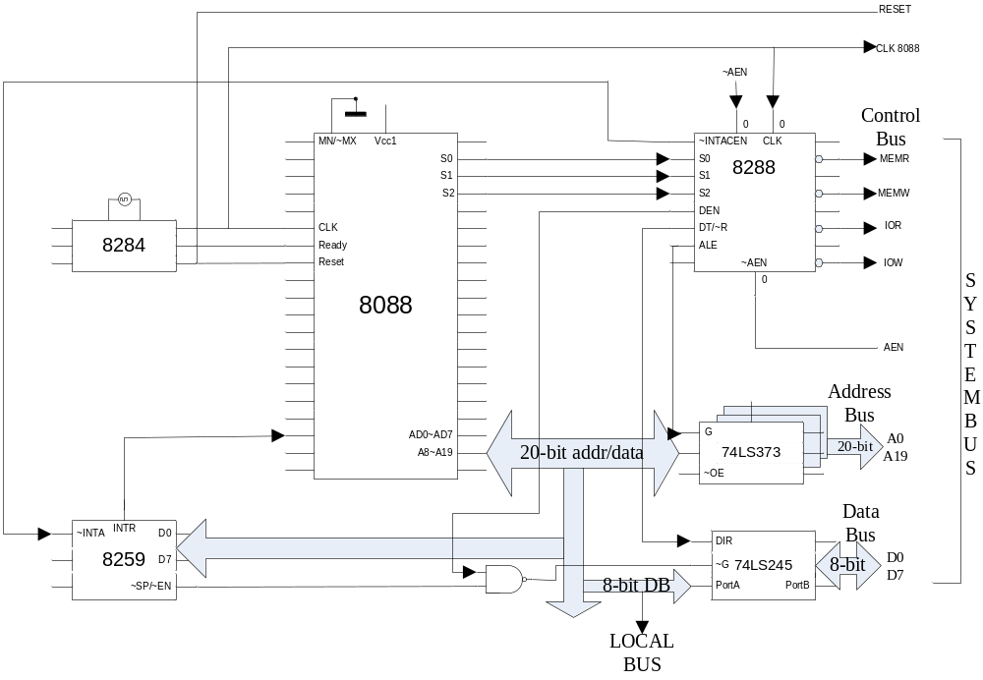
The construction of a IBM PC
- Notice the role 74LS373/245 in isolating the local buses and the system buses
Notes:
Next, let’s look at each of the buses.

Slide 14
Section9.3
8-bit Section of ISA Bus
Address bus
  The 74LS373 is used to fetch and isolate AB;
  If AEN is low, the CPU takes control of local buses; and address is released by the CPU;
  ALE is used to selecct the buffer IC, and address will be latched by the following CLK age.
  To isolate local and system buses, the system buses must be allowed to be used by DMA or any other boards without disturbing the CPU. This is achieved by connecting the AEN to 74LS373 ~OE PIN (active-low). When ~OE is not activated, the chip is in a high-resistance mode, so that the system bus is isolated.

Slide 15
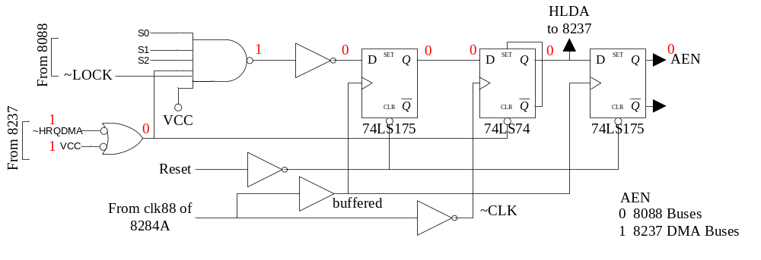
Section9.3
8-bit Section of ISA Bus
Figure 9-13 AEN generation circuitry in the IBM PC/XT
When ~HRQDMA =HIGH, there is no DMA request, and ~LOCK=LOW; as a sequence, AEN=LOW, buses controlled by CPU;
If the 8237 made ~HRQDMA low to send a DMA request to CPU. Whe the current memory cycle is finished (S0~S2->1, passive mode), the CPU will release ~LOCK=HIGH, and a HIGH is fed to the 74LS175. As a sequence, at the beginning of the following CLK cycle, AEN=HIGH, buses controlled by DMA controller 8137, and HLDA is toggled to HIGH to indicate 8237 that the DAM request is accepted.

Slide 16
Section9.3
8-bit Section of ISA Bus
Data bus
  AB is unidirectional, while DB is bidirectional;
  IC 74LS245 is used for isolation.
  DT/~R is used to indicate the trans direction of the signal; it is connected to the DIR pin.
  DEN (active-low) is used to used to enable the tri-state transceiver. When DEN is high, no transition is permitted. So that system bus is isolated.

Slide 17
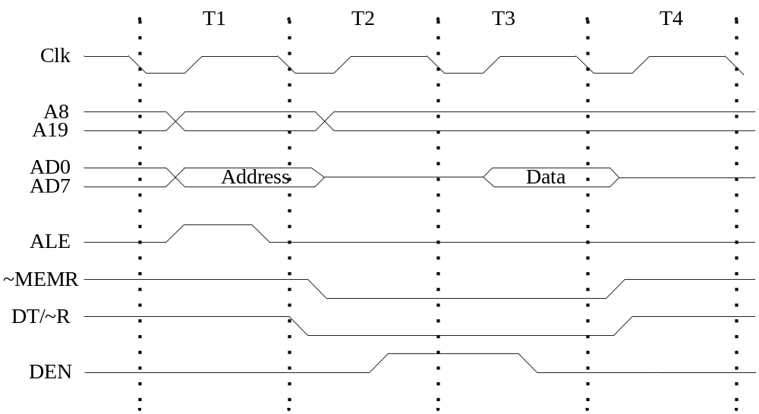
Section9.3
8-bit Section of ISA Bus
Control bus
  Compared with the minimum mode, DEN is used to lock the buses.

Slide 18
Section9.3
8-bit Section of ISA Bus
One bus, two masters
  Data transfer is time consuming
  DMA controller 8237 is developed to manage data transfer between memory and devices
  While 8237 gains control of the bus, the CPU lose controls. So there must be a way to allow either the processor or the DMA controller to gain control over the buses. This is called bus arbitration.
  Bus Arbitration is achieved by the AEN (address enable) generation circuitry (Figure 9-13).
Notes:
The 8237 will be discussed in Chapter 15.

Slide 19
Section9.3
8-bit Section of ISA Bus
AEN signal generation
  When DMA controller receives a DMA request, it puts LOW on HRQDMA (which is connected to the HOLD pin of 8088 CPU)
  If the bus is not locked by the CPU, the HLDA will to be return to DMA controller, and AEN to be set, so that control is transferred to the DMA controller.
  (see figure 9-13)

Slide 20
Section9.3
8-bit Section of ISA Bus
Bus boosting
  A signal (high level) will lose its power while transport along the bus. So it needs to be amplified;
  Several pin connected to a single wire will produce a large input capacitor load. So the signal should be strong enough to drive all the inputs.
  It is common to combine the functions of bus isolation and bus boosting into a single chip. (74LS373 for example)

Slide 21
Section9.3
8-bit Section of ISA Bus
8-bit section of the ISA bus
  The 16-bit bus system used in IBM PC/AT(80286) is known as the ISA bus.
  Figure 9-14 provides an over view of 8-bit ISA bus, which is a subset of the 16-bit one.
  AB and DB and AEN, IOW, IOR is are signals required to do I/O operation; other ctrl bus signals are used for interrupt handling, and DMA operation.

Slide 22
Additional Sector: PCI bus
The history of PCI bus
  The prototype of PCI bus is released by Intel group in 1990, in order to enhance replace ISA and enhance it with new characters, while be compatible with ISA devices.
  PCI was immediately adopted by Intel servers, replacing EISA buses. In mainstream PCs, PCI was slower to replace VESA Local Bus (VLB), and did not gain significant market penetration until late 1994 in second-generation Pentium PCs.

Slide 23
Additional Sector: PCI bus
  By 1996, manufacturers had adopted PCI even for 486 computers. EISA continued to be used alongside PCI through 2000.
  Apple Computer adopted PCI for professional Power Macintosh computers (replacing NuBus) in mid-1995.
  Later revisions of PCI added new features and performance improvements, including a 66 MHz 3.3 V standard and 133 MHz PCI-X, and the adaptation of PCI signaling to other form factors. Both PCI-X 1.0b and PCI-X 2.0 are backward compatible with some PCI standards.

Slide 24
Additional Sector: PCI bus
Specifications represent the most common version of PCI used in normal PCs
  33.33 MHz clock with synchronous transfers
  Peak transfer rate of 133 MB/s (133 megabytes per second) for 32-bit bus width (33.33 MHz × 32 bits ÷ 8 bits/byte = 133 MB/s)
  32-bit bus width
  32- or 64-bit memory address space (4 gigabytes or 16 exabytes)
  32-bit I/O port space
  256-byte (per device) configuration space
  5-volt signaling, also support 3.3 low voltage signaling
  Reflected-wave switching

Slide 25
Additional Sector: PCI bus
New features of PCI
  1) Auto configuration:
    Besides MEM and IO spaces, a third address space, called the PCI Configuration Space, is allocated.
    It uses a fixed addressing scheme, allows software to determine the amount of memory and I/O address space needed by each device.

Slide 26
Additional Sector: PCI bus
New features of PCI
  1) Auto configuration:
    It uses a fixed addressing scheme, allows software to determine the amount of memory and I/O address space needed by each device.
    The PCI configuration space also contains a small amount of device type information, which helps an operating system choose device drivers for it, or at least to have a dialogue with a user about the system configuration .

Slide 27
Additional Sector: PCI bus
New features of PCI
  2) New Interrupt schema:
    In the PCI system, the interrupt lines can be shared by many devices;
    The mapping of PCI interrupt lines onto system interrupt lines is configurable. The IRQ is assigned by the BIOS program during Auto-configuration phases, and is writen back into configure space;
    PCI interrupt lines are level-triggered. So the interrupt source will hold its requirement until it is served.

Slide 28
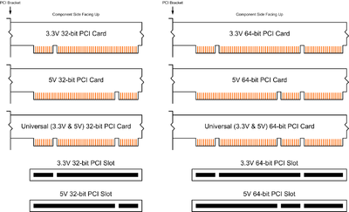
Additional Sector: PCI bus
Connector pinout

Slide 29
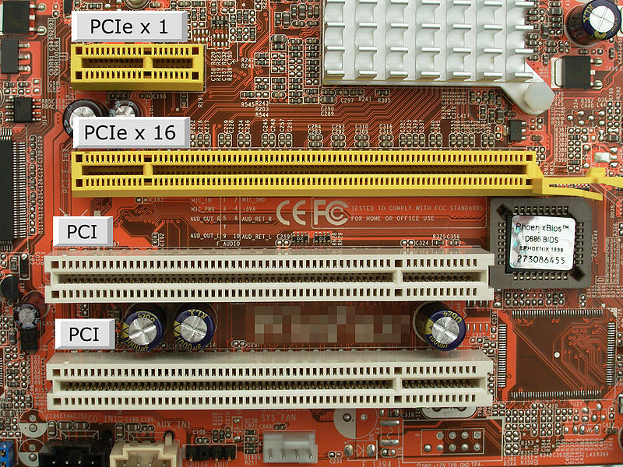
Additional Sector: PCI bus
Example of a motherboard with PCI and PCIe slots

Slide 30
Additional Sector: PCI bus
The of PCI bus bases platform:
  PCI is a type of system bus. It requires a bridge between it and the host’s local bus.
  PCI is designed to be compatible with ISA. It also require a bridge between it and other old type buses.

Slide 31
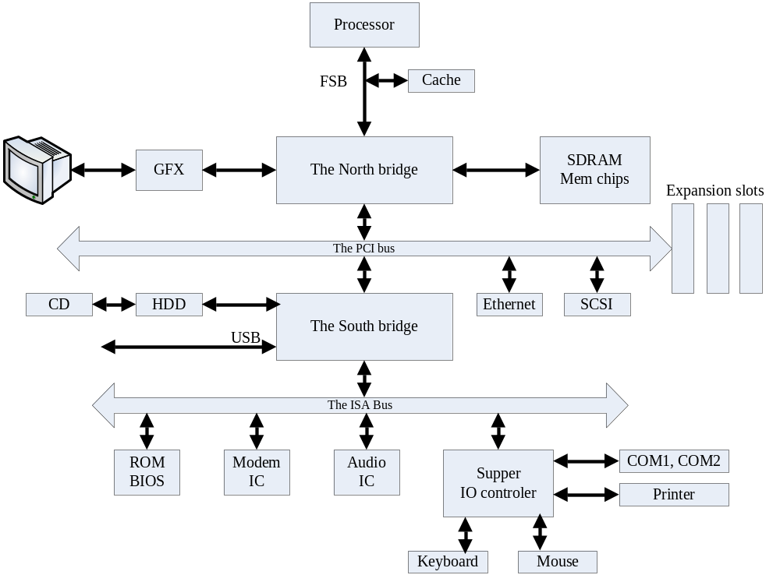

Slide 32
Additional Sector 2: PCIe Bus
PCIe (Peripheral Component Interconnect Express) is a high-speed serial system bus. It is designed to replace the old PCI (PCI-X) and AGP bus standards.

Slide 33
Additional Sector 2: PCIe Bus
Why change into a serial bus?
  Transferring latency: It takes time for a signal to be transferred from one point to an other. The far the distance is, the long the latency will be.
  In a parallel bus, the length of all the signal wires can not be the same. Thus the transferring latency can not be the same. This is called timing skew.
  We define: T_{delay}=latency₁ – latency₂.
  If the frequency of the signal is not so high, T_{delay} can not be perceived.
  However, if the frequency of the signal is too high, that T_{delay} approximates half of T_{cycle}, then the timing skew will ruin the synchronization of parallel signals.

Slide 34
Additional Sector 2: PCIe Bus
The key difference between conventional PCI and PCIe bus is the bus topology.
  PCI uses a shared parallel bus architecture
  PCIe is based on point-to-point topology.
    Root complex device: The central device in a PCIe bus. It connects the local bus with the system bus. Just like the host bridge in a PCI system.
    All the other pcie devices are connected directly with root complex device individually.

Slide 35
Additional Sector 2: PCIe Bus
In a shared bus linked topology system, access to the bus is arbitrated. And the bus clock has to be decreased be the same as the slowest device on the bus.
In a star topology system, full-duplex communication can be done individually.

Slide 36
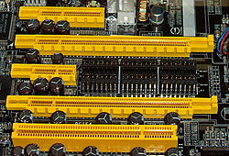
Additional Sector 2: PCIe Bus
In PCIe, the transferring channel between two devices is called a Lane .
PCIe port with only one lane is called PCIe x1; One pcie slot can implements up to 32 lanes .
A PCIe card can fit into a slot of its own size or larger, but may not fit into a smaller slot. The lanes really involved in communication is negotiated when initialization.
From top to bottom:
PCI express x4, x16, x1, x16;
Conventional PCI

Slide 37
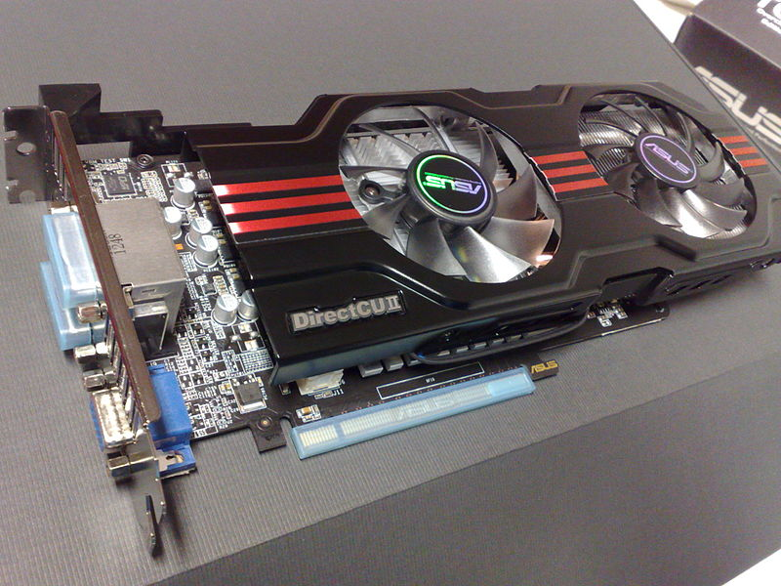
Additional Sector 2: PCIe Bus
An example of PCIe x 16 device: GTX 650 video card.

Slide 38
Additional Sector 2: PCIe Bus
PCIe sends all control messages, including interrupts, over the same links used for data.
Data transmitted on multiple-lane links is interleaved, meaning that each successive byte is sent down successive lanes. The PCIe specification refers to this interleaving as data striping.

Slide 39
Additional Sector 2: PCIe Bus
In order to implement PCIe, the system is divided into 3 layers
  Physical layer: defines the connection and electronic regulation for PCIe. It can be divided into electrical and logical sublayers.

Slide 40
Additional Sector 2: PCIe Bus
In order to implement PCIe, the system is divided into 3 layers
  Data link layer:
    sequence the transaction layer packets (TLPs) that are generated by the transaction layer,
    ensure reliable delivery of TLPs between two endpoints via an acknowledgement protocol (ACK and NAK signaling) that explicitly requires replay of unacknowledged/bad TLPs
    initialize and manage flow control credits

Slide 41
Additional Sector 2: PCIe Bus
In order to implement PCIe, the system is divided into 3 layers
  Transaction layer: organize the TLP transferring.
  Tran_layer uses a credit-based flow control protocol. In such a scheme
    the Rx device must declare its credit limit based on its Rx buffer depth before the transferring
    The Tx device sends out packages while consuming Rx’s credits.
    If the Rx has empted the Rx buffer, it will restore its credite.

